Slide 1
Cafeteria Management System
Project in C/Data Structure
Group:- Rohan Jain , Harshit Kumar ,
Sanket Jain , Nikhil Badgujar , SaiTarun

Slide 2
INTRODUCTION
The proposed topic Cafeteria Management System (hereafter called “CMS”) is a computer-based system that will allow Cafeteria Administrator to create online to assist Customer can order to cafeteria. The Customer and Admin will be more comfortable and happy about cafeteria service.

Slide 3
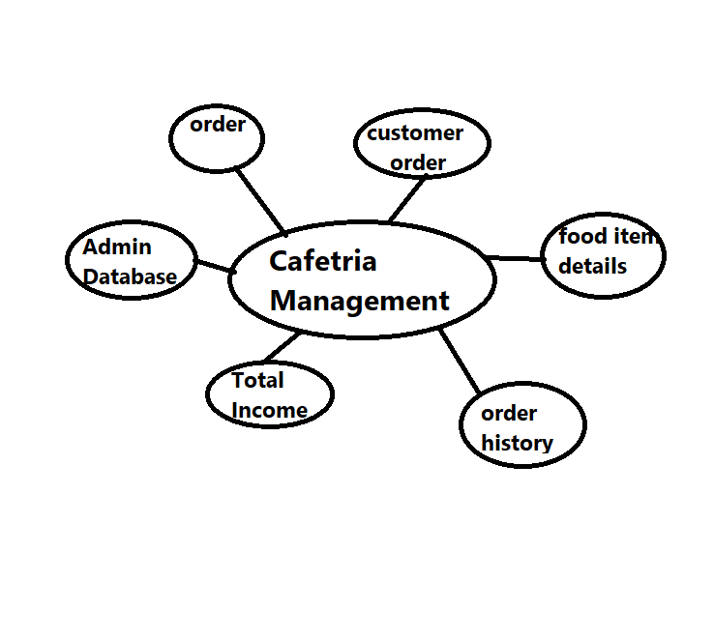
Use Case Diagram

Slide 4
User Requirement
• The customer or the admin to log in their homepages.
• The users check out the selected product.
• The admin can add the new food/drink.
• The admin can update the information of the store.
• The admin can delete food/drink.
• The admin can view the report.

Slide 5
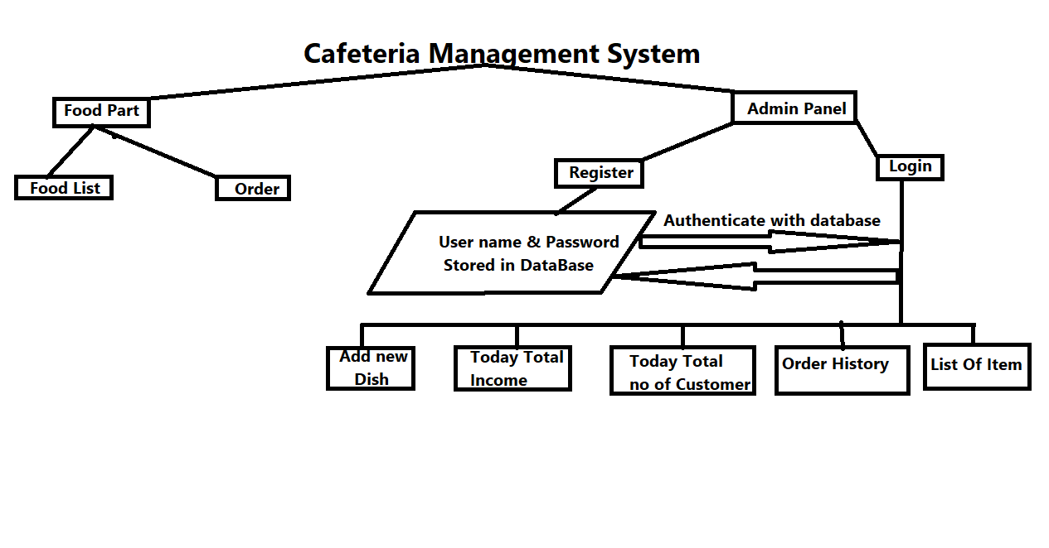
Work Flow Diagram

Slide 6
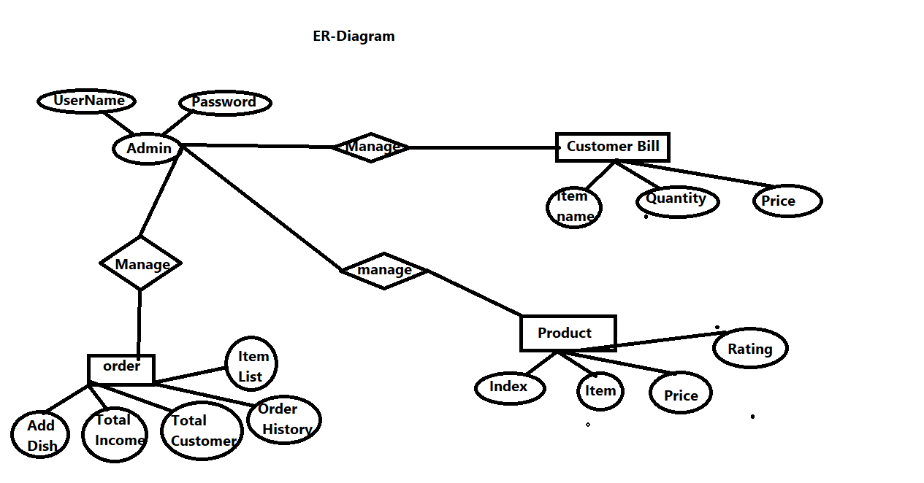
Entity-Relationship Diagram

Slide 7
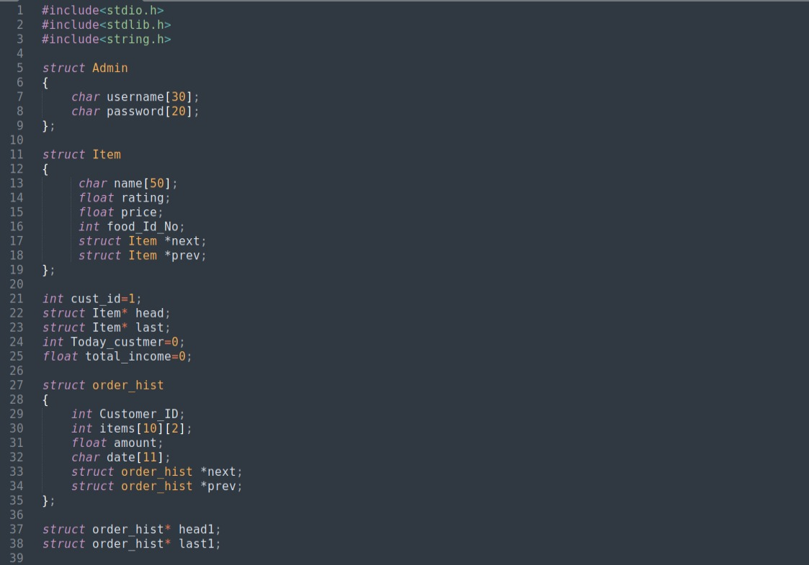
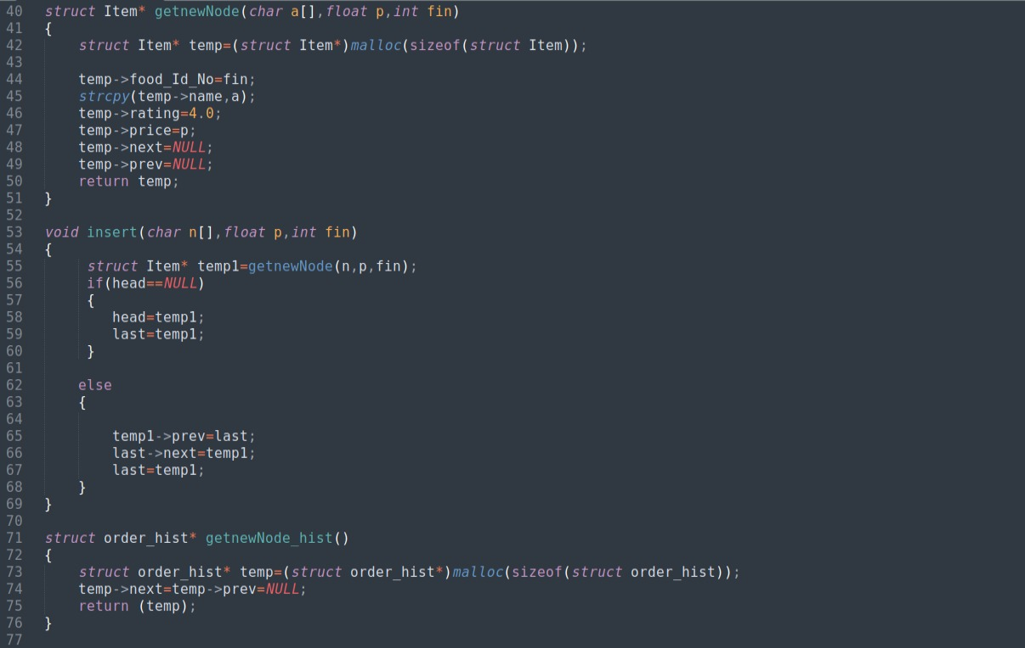
Code Snaps

Slide 8
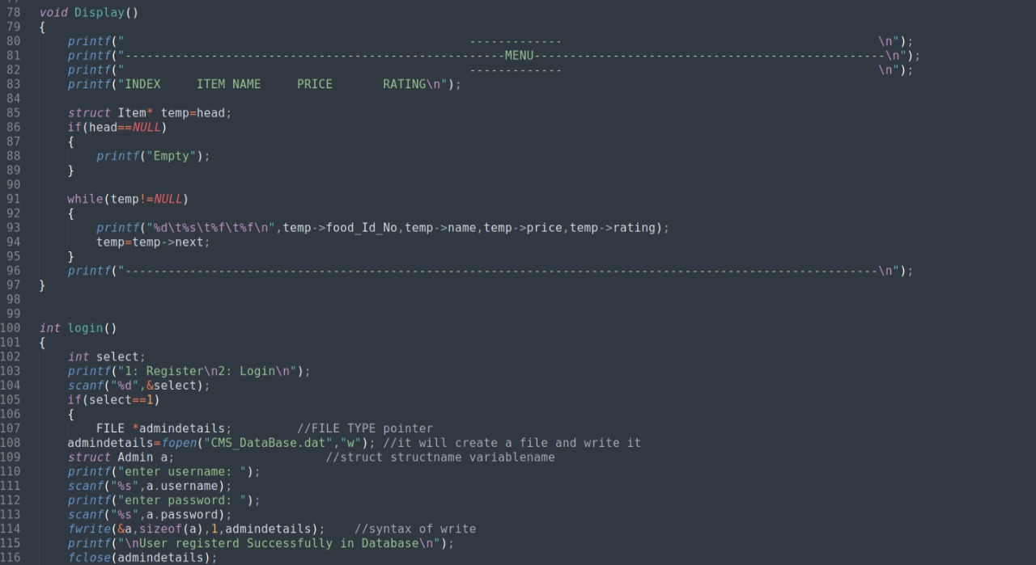
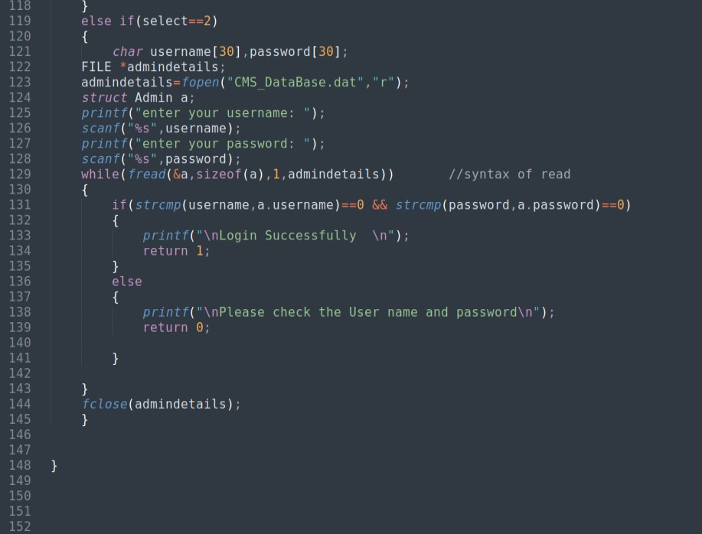

Slide 9
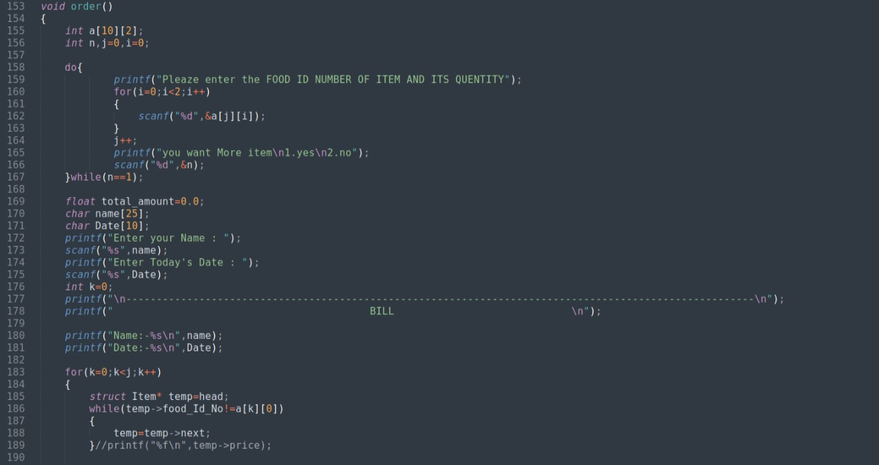
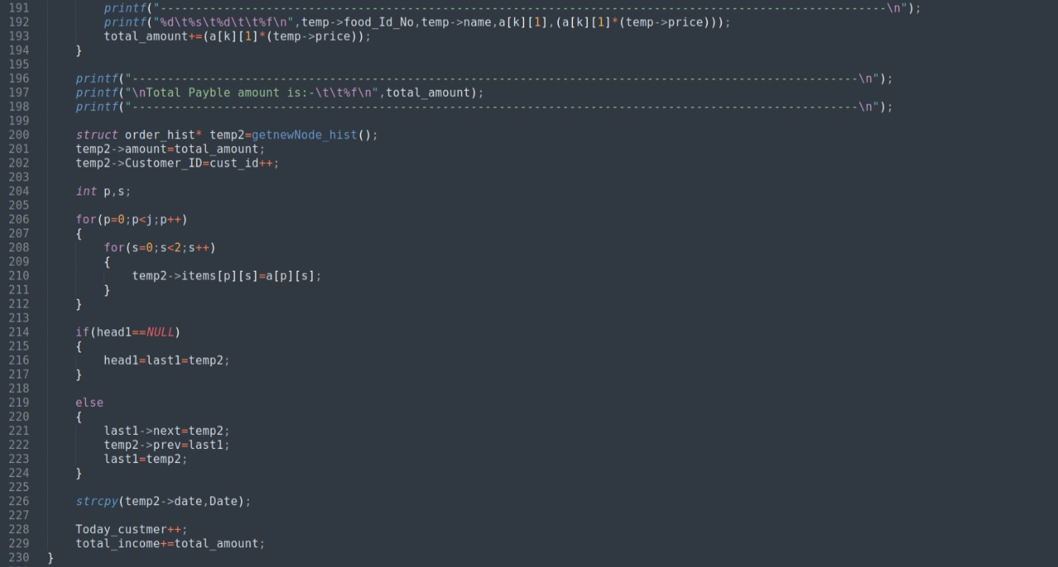

Slide 10
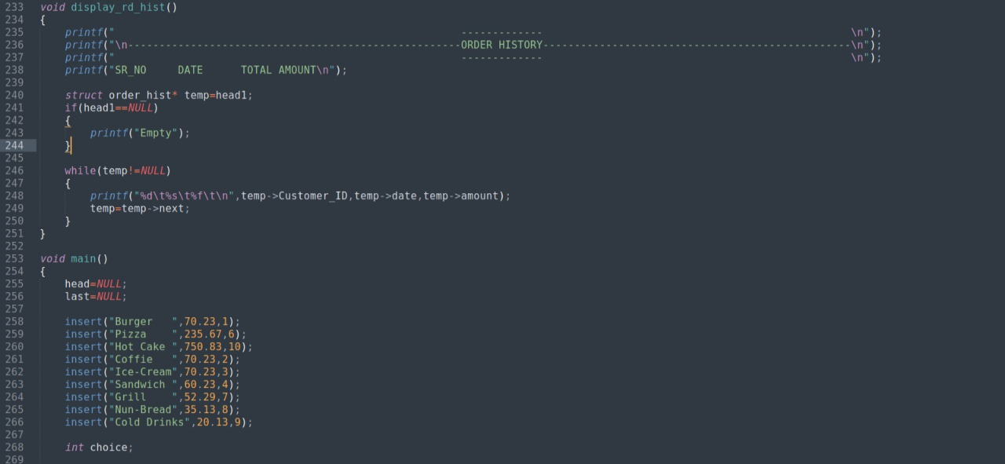
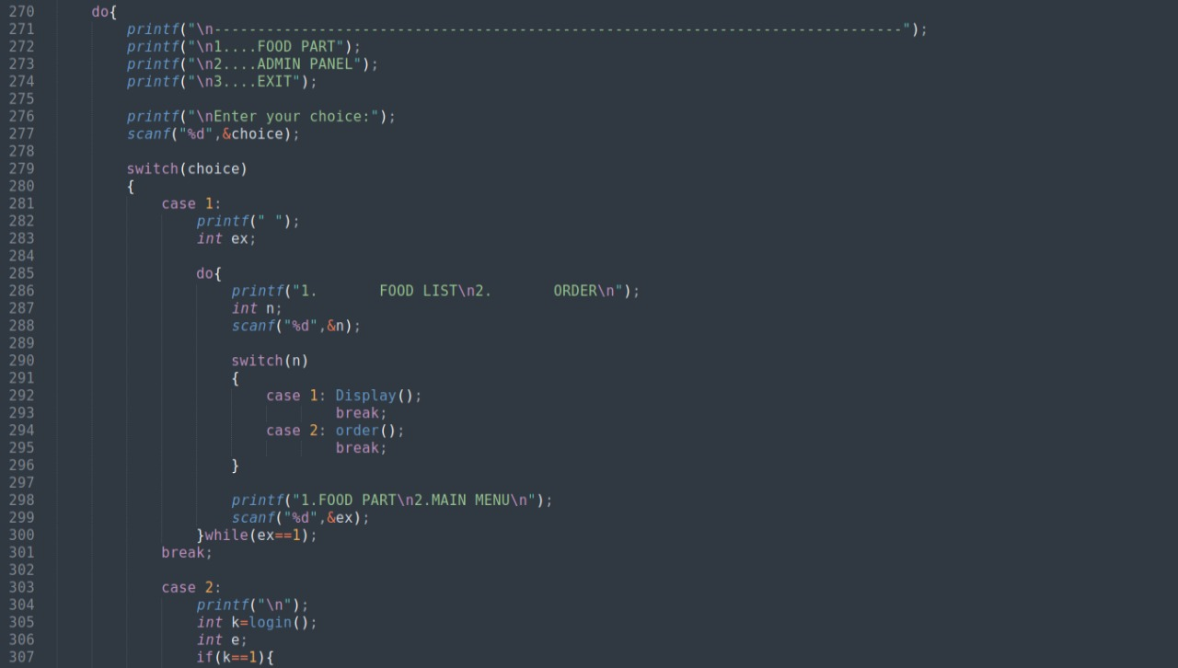

Slide 11
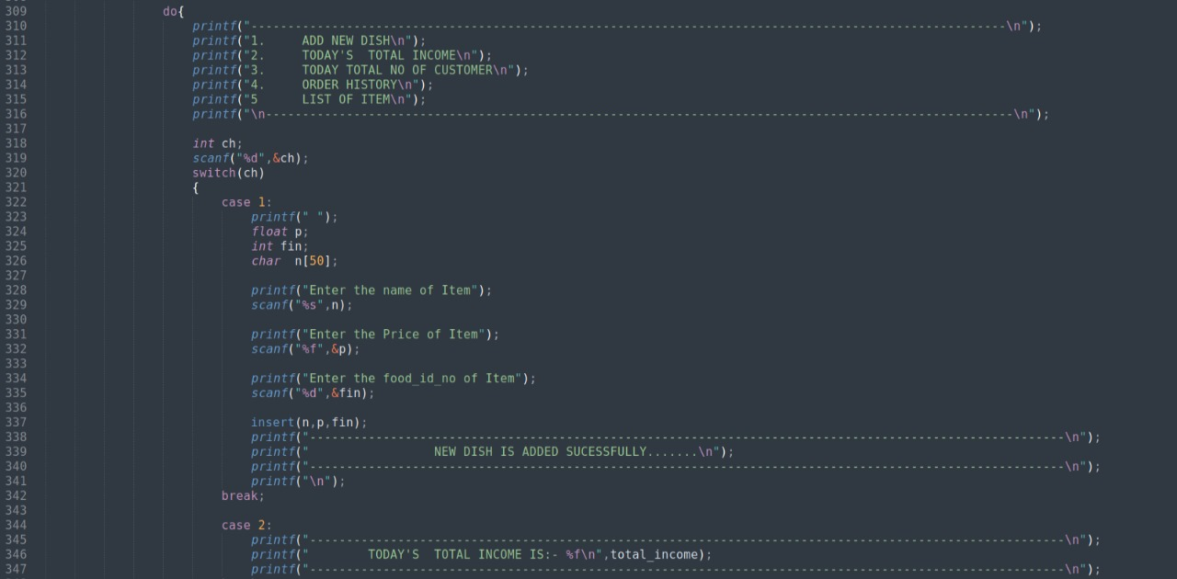
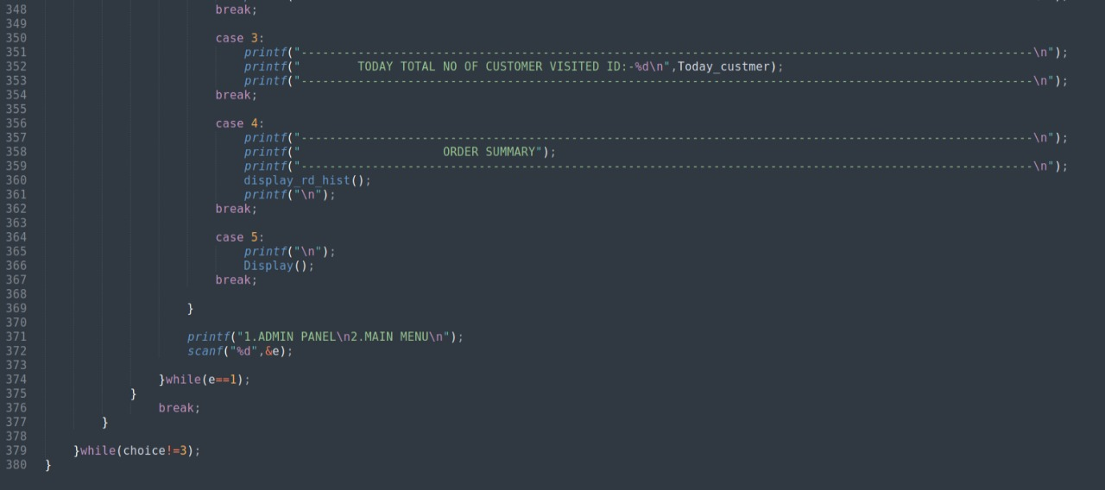

Slide 12
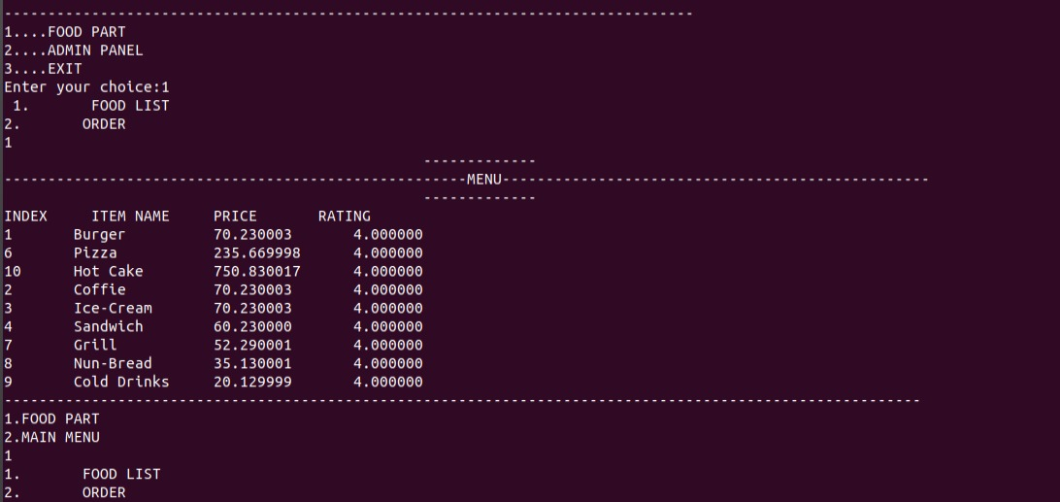
Working Snaps

Slide 13
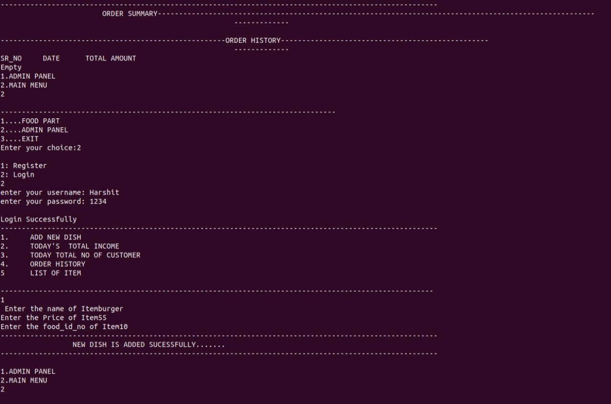

Slide 14
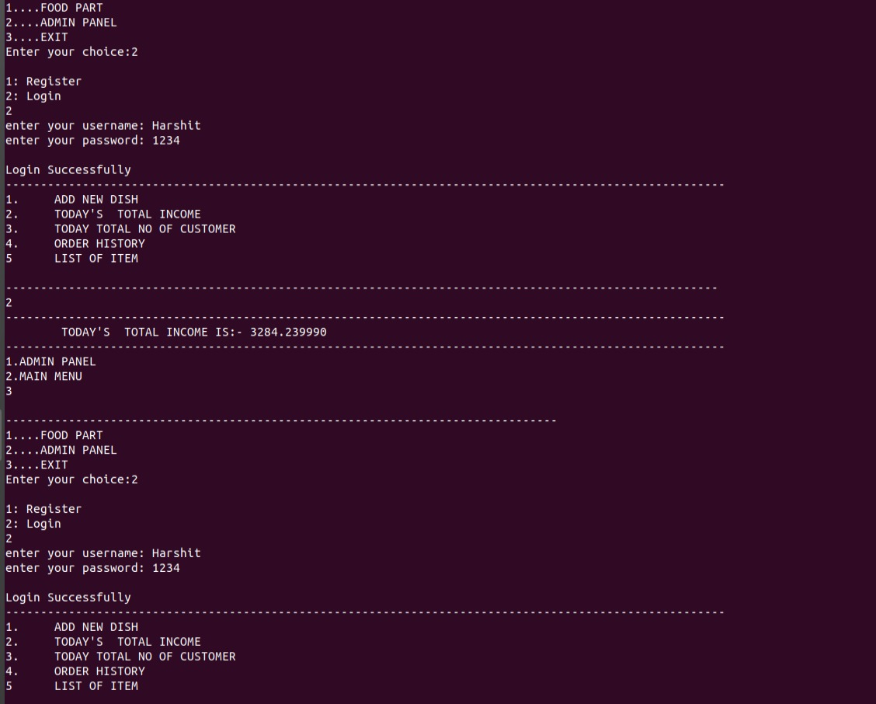

Slide 15
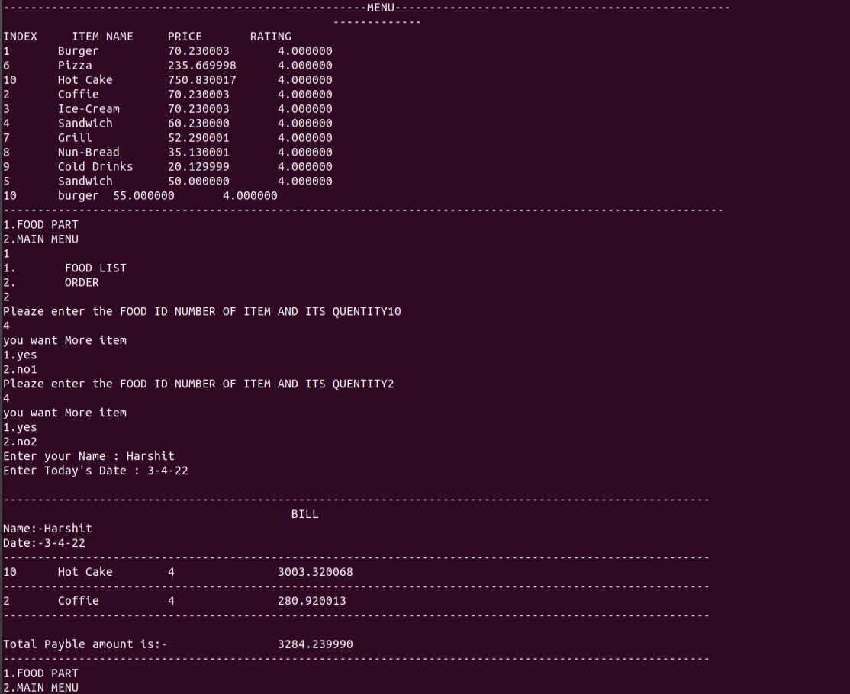

Slide 16
Google Drive Link
https://drive.google.com/drive/folders/1pWZFPBsvDPKBIFcMrPfd0HpL3woDQUT4

Slide 17
THANK YOU

